Slide 1
Angle Modulation
Prepared by
Rifat Rahman
Assistant Professor
Institute of Appropriate Technology, BUET
https://rrahman007.buet.ac.bd
and
Prof. Hitesh Dholakiya

Slide 2
Angle Modulation
Outlines
Basics of Angle Modulation
Advantages of Angle Modulation
Applications of Angle Modulation

Slide 3










Basics of Angle Modulation
In Angle Modulation, the Frequency or Phase of the Carrier Signal Changes with respect to the Modulating Signal.
There are Two Types of Angle Modulation.
Frequency Modulation
Phase Modulation
In Frequency Modulation, the Frequency of the Carrier Signal changes with respect to the
Modulating Signal.
Let the Carrier Signal is given by:  Then, the Frequency Modulated Signal is given by:
⟹ 𝐂 𝐭 = 𝐕_{𝐂} 𝐜𝐨𝐬 𝛚_{𝐜}𝐭 + 𝛟 ⟹ 𝐘_{𝐅𝐌} 𝐭 = 𝐕_{𝐂} 𝐜𝐨𝐬 𝛚 𝐭 𝐭 + 𝛟
Here, 𝛚 𝐭 is a function of the Message Signal 𝐦 𝐭 .
In Phase Modulation, the Phase of the Carrier Signal changes with respect to the Modulating Signal.
Let the Carrier Signal is given by:  Then, the Phase Modulated Signal is given by:
⟹ 𝐂 𝐭 = 𝐕_{𝐂} 𝐜𝐨𝐬 𝛚_{𝐜}𝐭 + 𝛟
⟹ 𝐘_{P𝐌} 𝐭 = 𝐕_{𝐂} 𝐜𝐨𝐬 𝛚_{𝐜}𝐭 + 𝛟 𝐭
Here, 𝛟 𝐭 is a function of the Message Signal 𝐦 𝐭 .

Slide 4
Advantages of Angle Modulation
1. Improved noise immunity compared to amplitude modulation.
Most noise in communication channels affects the amplitude of signals.
In angle modulation, the amplitude of the carrier does not contain information. The information is stored in:
- Frequency (FM)
- Phase (PM)
So even if noise changes the amplitude, the information remains unaffected.
2. Constant amplitude reduces power loss due to non-linearities in amplifiers.
In angle modulation, the carrier amplitude is constant.
Because the amplitude does not change:
- Amplifiers can operate in non-linear modes (reduce power loss)
- High efficiency amplifiers can be used
In contrast, in AM the amplitude varies.
If a nonlinear amplifier is used with AM, distortion occurs because the amplitude contains information.

Slide 5
Advantages of Angle Modulation
3. Better signal quality, especially for FM radio (less distortion).
[Capture Effect] If two FM signals arrive at the receiver:
- The stronger signal (determined by the received signal power) dominates
- The weaker signal is suppressed
AM receivers mix both signals, causing distortion.
4. Higher efficiency in bandwidth use with proper techniques (e.g., narrowband FM).
Narrowband FM reduces bandwidth significantly.
5. Less susceptible to signal fading and amplitude variations.
Fading occurs when signal amplitude fluctuates due to:
- multipath propagation
- obstacles
- atmospheric conditions
In AM, fading directly affects the message
In angle modulation, Amplitude variations are ignored by the receiver using limiters (A limiter circuit removes amplitude fluctuations before demodulation).

Slide 6
Applications of Angle Modulation
FM radio broadcasting (88 – 108 MHz): High fidelity audio transmission.
Two-way radio communications (police, fire, emergency services).
Television sound transmission (Analog TV).
Satellite and space communication: Used due to robustness against noise.
Radar and telemetry systems.

Slide 7
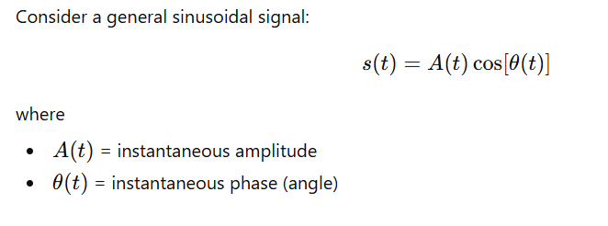
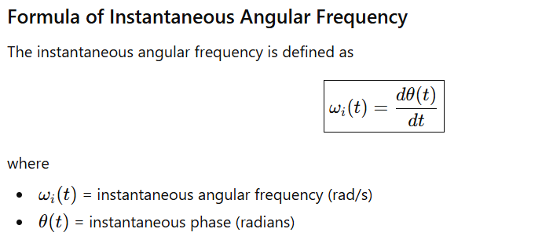

Instantaneous Angular Frequency
Instantaneous angular frequency is the rate of change of the instantaneous phase (angle) of a signal with respect to time.
In other words, it tells us how fast the phase of a signal is changing at a particular instant. It represents the instantaneous rotational speed of the signal's phasor in radians per second.

Slide 8
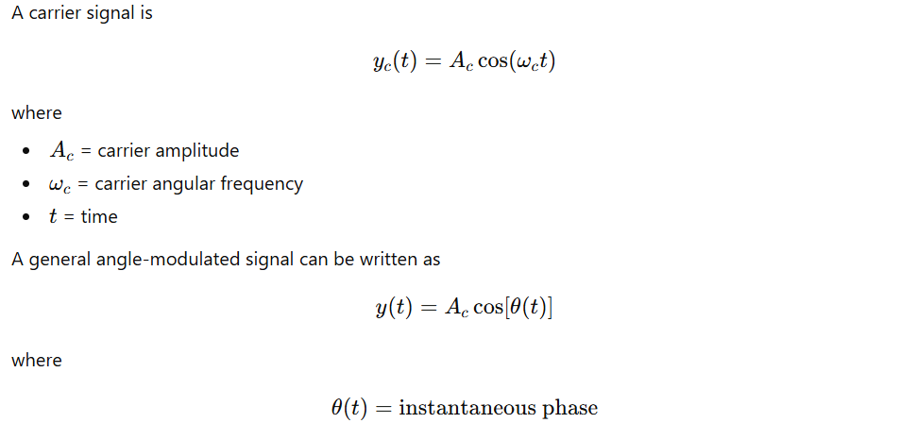
General Carrier Signal

Slide 9
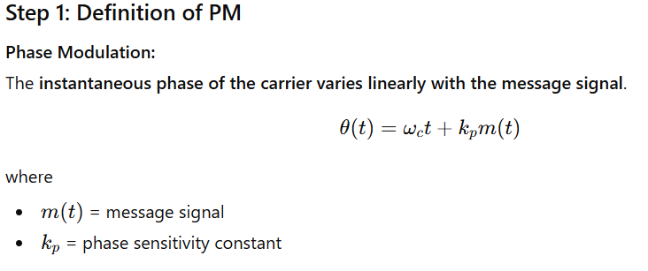
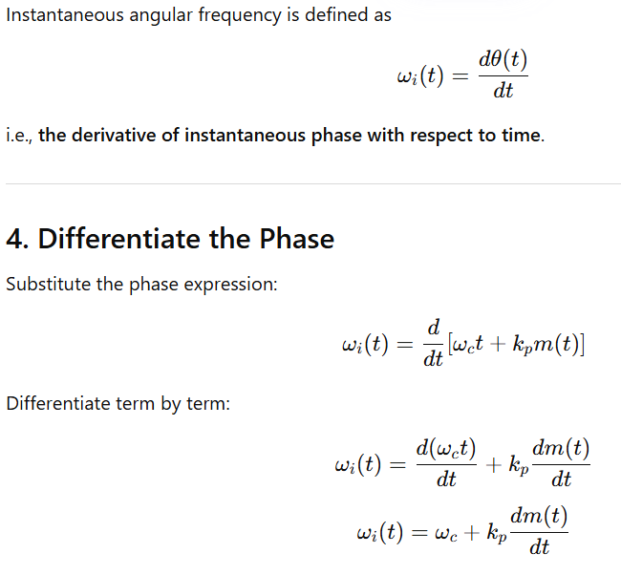
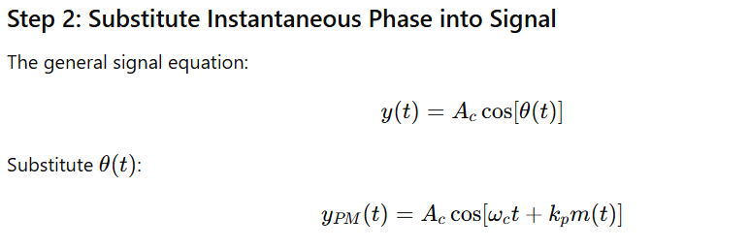
Derivation of Phase Modulation (PM)

Slide 10
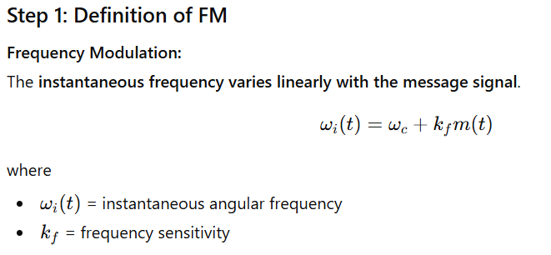
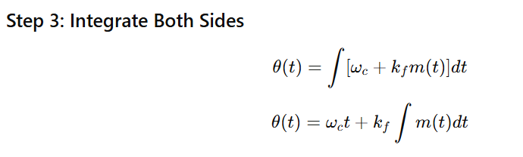
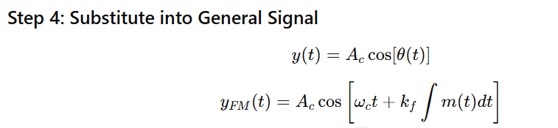
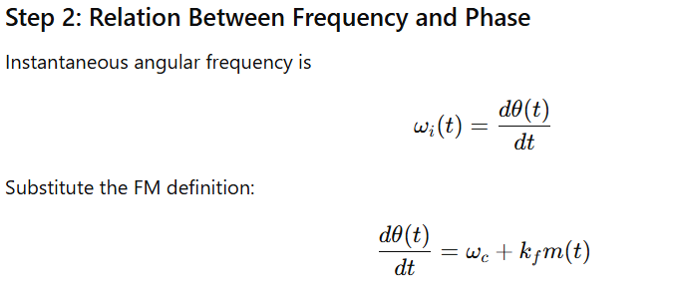
Derivation of Frequency Modulation (FM)

Slide 11
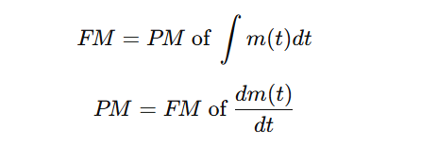
Important Concept

Slide 12
Frequency Modulation
Outlines
Basics of Frequency Modulation
Block Diagram of Frequency Modulator
Waveforms of Frequency Modulator
Square Wave Frequency Modulation

Slide 13







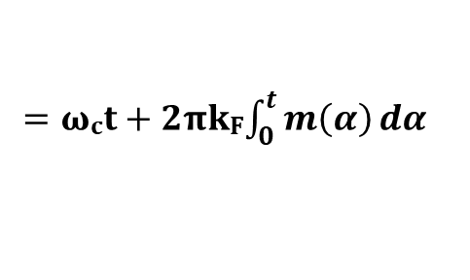
Basics of Frequency Modulation
In Frequency Modulation, the Frequency of the Carrier Signal changes with respect to the Modulating Signal.
Let the Carrier Signal is given by:  Then, the Frequency Modulated Signal is given by:
⟹ 𝐂 𝐭 = 𝐕_{𝐂} 𝐜𝐨𝐬 𝛚_{𝐜}𝐭 ⟹ 𝐘_{𝐅𝐌} 𝐭 = 𝐕_{𝐂} 𝐜𝐨𝐬 𝛚 𝐭 𝐭 = 𝐕_{𝐂} 𝐜𝐨𝐬 𝛉 𝐭
Here, 𝛚 𝐭 and 𝛉 𝐭 is a function of the Message Signal 𝐦 𝐭 .
Frequency Modulation is a part of the Angle Modulation, The Angle of Frequency Modulation is given by:
= 𝛚_{𝐜}𝐭 + 𝟐𝛑𝐤_{𝐅}$\int_{0}^{t}{m\left(α\right)ⅆα}$
⟹ 𝛉 𝐭
𝐤_{𝐅} is frequency Sensitivity, Unit is Hz/Volt.

Slide 14






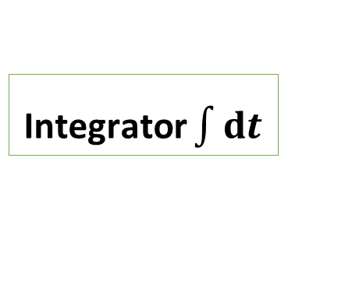


Block Diagram of Frequency Modulator
First, The Message Signal 𝐦 𝐭 is given to the Integrator.
Then the Integrated Message Signal and Carrier Signal is given to the Phase Modulator.
Phase Modulator generates a Frequency Modulated wave and its Angle is given by:
= 𝛚_{𝐜}𝐭 + 𝟐𝛑𝐤_{𝐅}$\int_{0}^{t}{m\left(t\right)ⅆt}$
⟹ 𝛉 𝐭
Here, 𝐤_{𝐅} is frequency Sensitivity, Unit is Hz/Volt.
Frequency Modulated Wave is given by:
𝛚_{𝐜}𝐭 + 𝟐𝛑𝐤_{𝐅}$\int_{0}^{t}{m\left(t\right)ⅆt}$
⟹ 𝐘_{𝐅𝐌} 𝐭 = 𝐕_{𝐂} 𝐜𝐨𝐬
𝐦 𝐭 Modulating Signal
Integrator $\int{ⅆt}$
Phase Modulator
F.M.
Wave
$$\int_{0}^{t}{m\left(t\right)ⅆt}$$
𝐂 𝐭 = 𝐕_{𝐂} 𝐜𝐨𝐬 𝛚_{𝐜}𝐭
C(t) Carrier Signal

Slide 15









Waveforms of Frequency Modulator
Amplitude Message Signal m(t)
Time t (Sec)
$$ω_{i}\left(t\right)=ω_{c}+k_{f}m\left(t\right)$$
Amplitude
Carrier Signal c 𝐭
$$k_{f} unit⇒rad/(sec.Volt)$$
𝐕_{𝐂}
$$f_{i}\left(t\right)=f_{c}+k_{f}m\left(t\right)$$
Time t (Sec)
$$k_{f} unit⇒Hz/Volt$$
−𝐕_{𝐂}
FM Signal 𝐘_{𝐅𝐌} 𝐭
$${2πf}_{i}\left(t\right)={2πf}_{c}+{2πk}_{f}m\left(t\right)$$
Amplitude
$$⇒ω_{i}\left(t\right)={ ω}_{c} +{2πk}_{f}m\left(t\right)$$
𝐕_{𝐂}
$$k_{f} unit⇒Hz/Volt$$
Time t (Sec)
−𝐕_{𝐂}

Slide 16



Square Wave Frequency Modulation
Amplitude Message Signal m(t)
Time t (Sec)
Amplitude
Carrier Signal c 𝐭
$$ω_{i}\left(t\right)=ω_{c}+k_{f}m\left(t\right)$$
𝐕_{𝐂}
$$f_{i}\left(t\right)=f_{c}+k_{f}m\left(t\right)$$
Time t (Sec)
−𝐕_{𝐂}
FM Signal 𝐘_{𝐅𝐌} 𝐭
$$ω_{i}\left(t\right)={ ω}_{c}+{2πk}_{f}m\left(t\right)$$
Amplitude
𝐕_{𝐂}
Time t (Sec)
−𝐕_{𝐂}

Slide 17
Phase Modulation
Outlines
Basics of Phase Modulation
Block Diagram of Phase Modulator
Waveforms of Phase Modulator
Square Wave Phase Modulator

Slide 18





Basics of Phase Modulation
In Phase Modulation, the Phase of the Carrier Signal changes with respect to the Modulating Signal.
Let the Carrier Signal is given by:  Then, the Phase Modulated Signal is given by:
⟹ 𝐂 𝐭 = 𝐕_{𝐂} 𝐜𝐨𝐬 𝛚_{𝐜}𝐭 ⟹ 𝐘_{𝐏𝐌} 𝐭 = 𝐕_{𝐂} 𝐜𝐨𝐬 𝛚_{𝐜}𝐭 + 𝛟 = 𝐕_{𝐂} 𝐜𝐨𝐬 𝛉 𝐭
Here, 𝛟 and 𝛉 𝐭 is a function of the Message Signal 𝐦 𝐭 .
Phase Modulation is a part of the Angle Modulation, The Angle of Phase Modulation is given by:
⟹ 𝛉 𝐭 = 𝛚_{𝐜}𝐭 + 𝐤_{𝐏}𝐦 𝐭
𝐤_{𝐏} is Phase Sensitivity, Unit is Rad/Volt.

Slide 19






Block Diagram of Phase Modulator
First, the Message Signal 𝐦 𝐭
Then the Differentiated Message Signal and the Carrier Signal are given to the
Frequency Modulator.
Frequency Modulator generates Phase Modulated wave and its Angle is given by:
is given to the Differentiator.
⟹ 𝛉 𝐭 = 𝛚_{𝐜}𝐭 + 𝐤_{𝐏}𝐦 𝐭
Here, 𝐤_{𝐏} is Phase Sensitivity, Unit is Rad/Volt.
Phase Modulated Wave is given by:
⟹ 𝐘_{𝐏𝐌} 𝐭 = 𝐕_{𝐂} 𝐜𝐨𝐬 𝛚_{𝐜}𝐭 + 𝐤_{𝐏}𝐦 𝐭
𝐦 𝐭 Modulating Signal
Differentiator
𝐝
𝐝𝐭
Frequency Modulator
P.M.
Wave
𝐝𝐦 𝐭
𝐝𝐭
𝐂 𝐭 = 𝐕_{𝐂} 𝐜𝐨𝐬 𝛚_{𝐜}𝐭
Carrier Signal
𝐂 𝐭

Slide 20
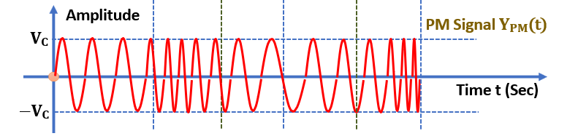


Waveforms of Phase Modulator
Amplitude
Message Signal m(t)
Derivative m’(t)
$$θ\left(t\right)=ω_{c}t+k_{p}m\left(t\right)$$
$$\frac{dθ(t)}{dx}=ω_{i}\left(t\right)=ω_{c}+k_{p}m′(t)$$
Time t (Sec)
Amplitude
Carrier Signal c(t)
𝐕_{𝐂}
Time t (Sec)
−𝐕_{𝐂}
Amplitude
PM Signal 𝐘_{𝐏𝐌}(t)
𝐕_{𝐂}
Time t (Sec)
−𝐕_{𝐂}

Slide 21


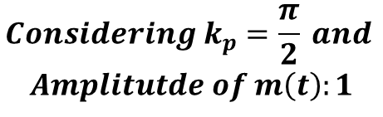


Square Wave Phase Modulation
Amplitude
Message Signal m(t)
Derivative m’(t)
$$θ\left(t\right)=ω_{c}t+k_{p}m\left(t\right)$$
$$\frac{dθ(t)}{dx}=ω_{i}\left(t\right)=ω_{c}+k_{p}m′(t)$$
Time t (Sec)
Amplitude
$$Carrier Signal, c\left(t\right)=V_{c}cos⁡(ω_{c}t)$$
𝐕_{𝐂}
Time t (Sec)
−𝐕_{𝐂}
Amplitude
PM Signal 𝐘_{𝐏𝐌} 𝐭
𝐕_{𝐂}
$$Considering k_{p}=\frac{π}{2} and$$
$$Amplitutde of m\left(t\right):1$$
Time t (Sec)
−𝐕_{𝐂}

Slide 22
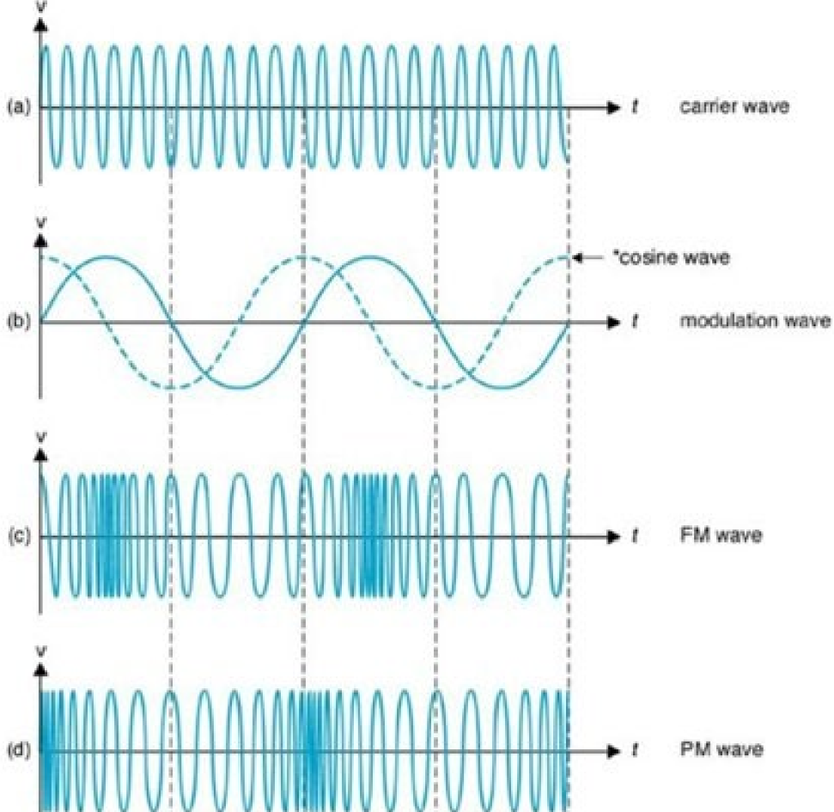
Waveforms of FM and PM

Slide 23
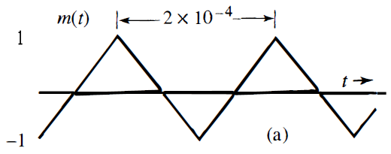
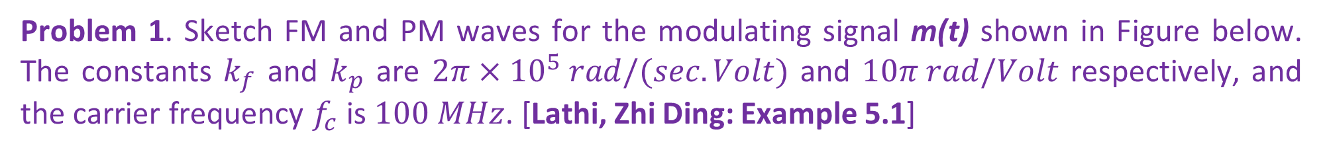
Problem 1. Sketch FM and PM waves for the modulating signal m(t) shown in Figure below. The constants $k_{f}$ and $k_{p}$ are $2π×{10}^{5} rad/(sec.Volt)$ and $10π rad/Volt$ respectively, and the carrier frequency $f_{c}$ is $100 MHz$. [Lathi, Zhi Ding: Example 5.1]

Slide 24
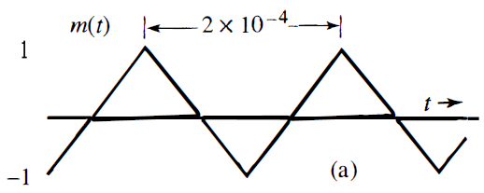
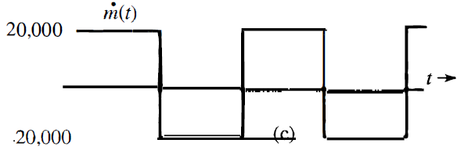
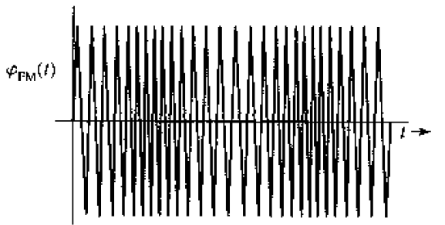
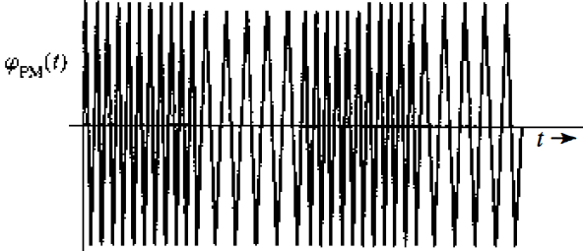
Solve:
Waveform

Slide 25
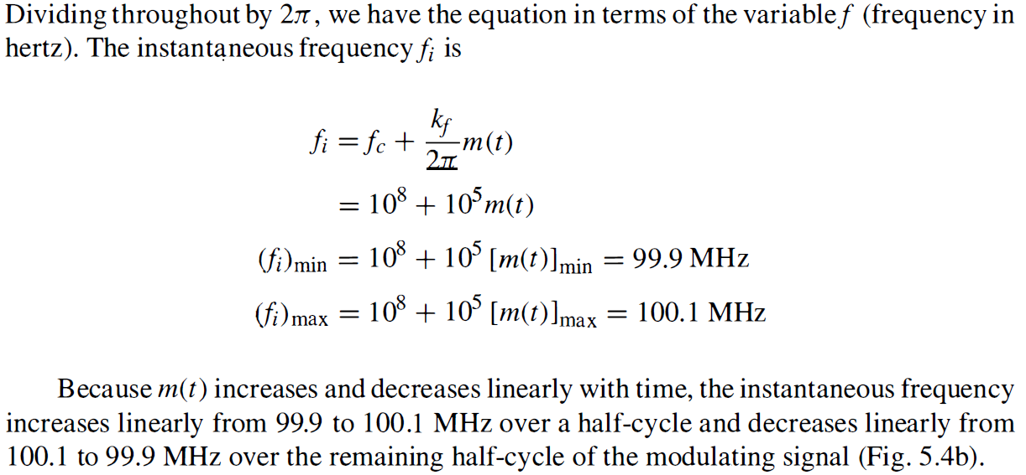

Slide 26
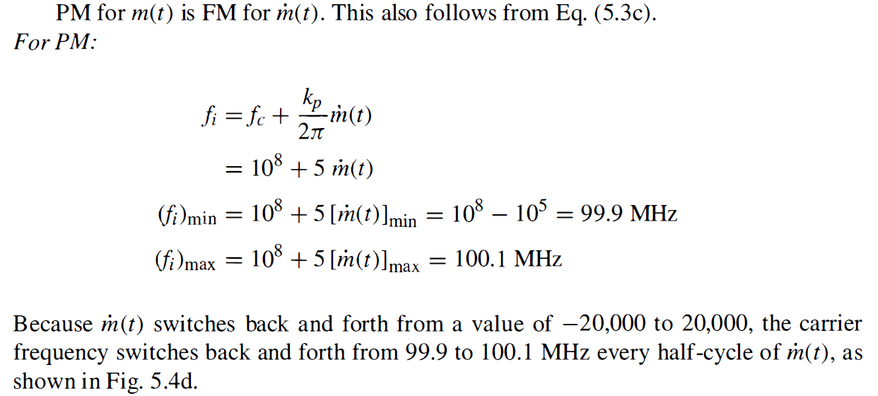

Slide 27
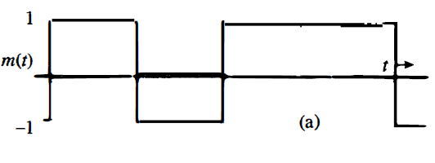
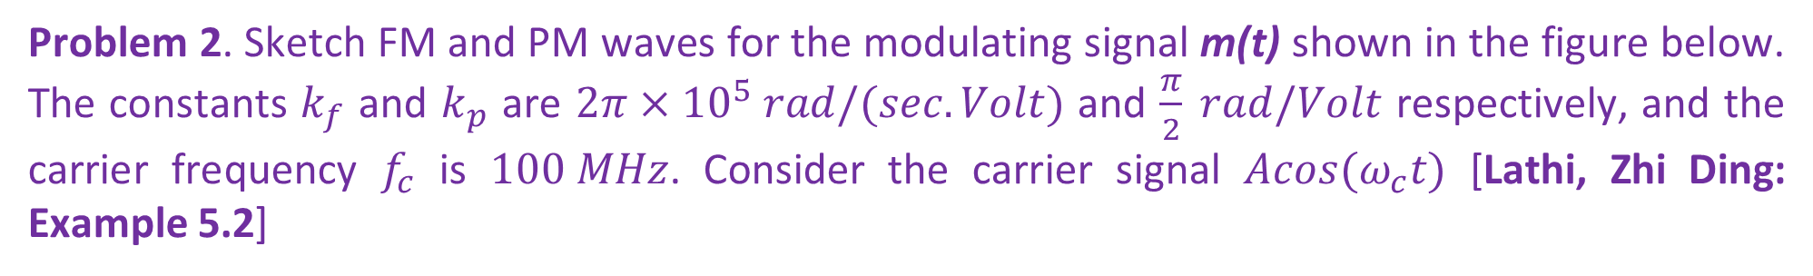
Problem 2. Sketch FM and PM waves for the modulating signal m(t) shown in the figure below. The constants $k_{f}$ and $k_{p}$ are $2π×{10}^{5} rad/(sec.Volt)$ and $\frac{π}{2} rad/Volt$ respectively, and the carrier frequency $f_{c}$ is $100 MHz$. Consider the carrier signal $Acos(ω_{c}t)$ [Lathi, Zhi Ding: Example 5.2]

Slide 28
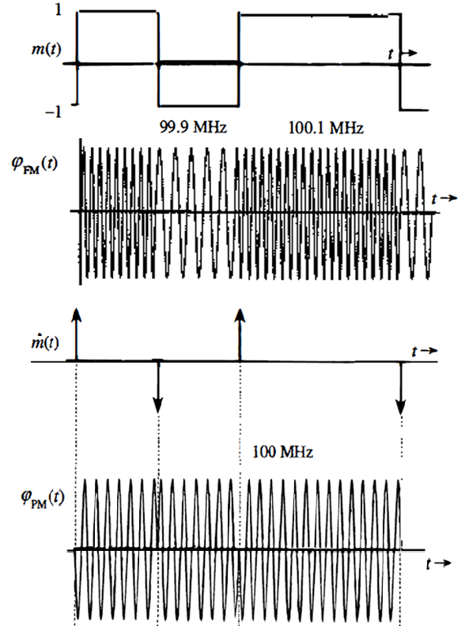
Solve:
Waveform

Slide 29
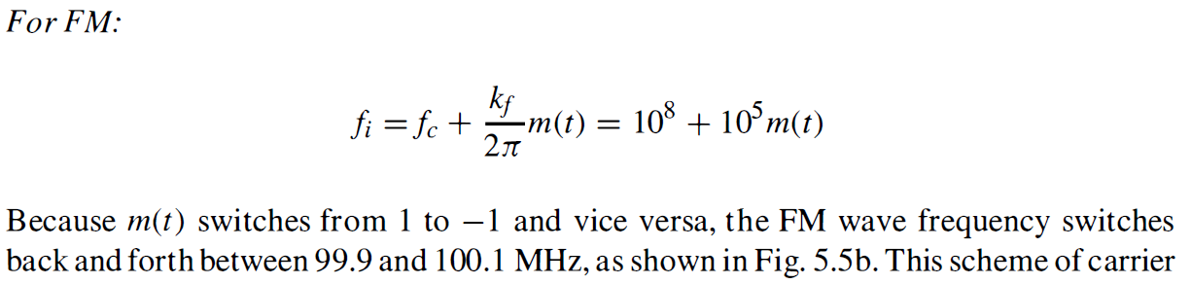

Slide 30
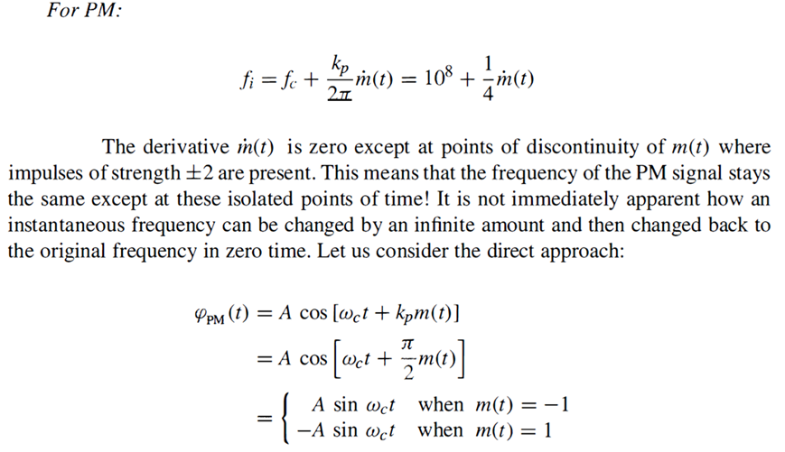

Slide 31
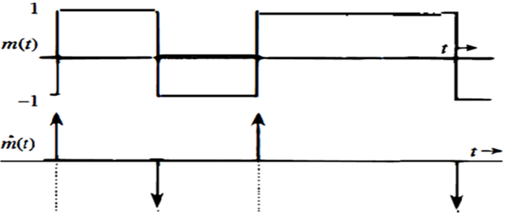

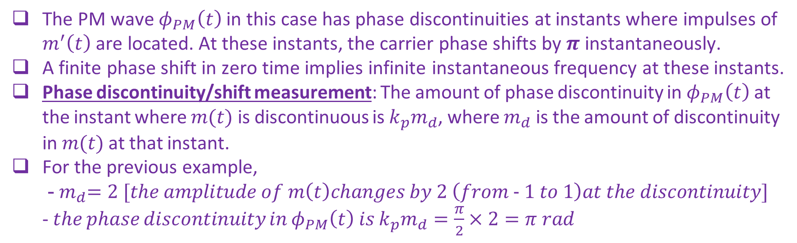
Phase Discontinuity and Phase Shift
The PM wave $φ_{PM}\left(t\right)$ in this case has phase discontinuities at instants where impulses of $m^{′}\left(t\right)$are located. At these instants, the carrier phase shifts by $π$ instantaneously.
A finite phase shift in zero time implies infinite instantaneous frequency at these instants.
Phase discontinuity/shift measurement: The amount of phase discontinuity in $φ_{PM}\left(t\right)$ at the instant where $m(t)$ is discontinuous is $k_{p}m_{d}$, where $m_{d}$ is the amount of discontinuity in $m(t)$ at that instant.
For the previous example,
-${ m}_{d}=2 [the amplitude of m\left(t\right)changes by 2 \left(from − 1 to 1\right)at the discontinuity]$
- 𝑡ℎ𝑒 𝑝ℎ𝑎𝑠𝑒 𝑑𝑖𝑠𝑐𝑜𝑛𝑡𝑖𝑛𝑢𝑖𝑡𝑦 𝑖𝑛 $φ_{PM}\left(t\right)$ 𝑖𝑠 $k_{p}m_{d}=\frac{π}{2}×2=π rad$

Slide 32
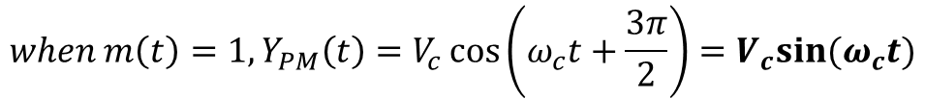
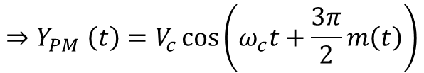




Ambiguity in Demodulation
Amplitude
Message Signal m(t)
1
-1/3
Time t (Sec)
For both values of m(t), PM signal is $V_{c}sin(ω_{c}t)$
How can we distinguish between $m\left(t\right)=1 and m\left(t\right)=−\frac{1}{3}$ during demodulation?
Such ambiguity never arises if $k_{p}m(t)$ is restricted to the range $\left(−π,π\right).$
In this case, phase Discontinuity/shift in PM wave is $k_{p}m_{d}=\left(\frac{3π}{2}×\left(1+\frac{1}{3}\right)\right)=2π$
Amplitude
$$Carrier Signal, c\left(t\right)=V_{c}cos⁡(ω_{c}t)$$
𝐕_{𝐂}
Time t (Sec)
−𝐕_{𝐂}
$$Considering k_{p}=\frac{3π}{2}$$
Amplitude
PM Signal 𝐘_{𝐏𝐌} 𝐭
𝐕_{𝐂}
$$Y_{PM}\left(t\right)=V_{c}\cos\left(ω_{c}t+k_{p}m\left(t\right)\right)$$
$${⇒Y}_{PM}\left(t\right)=V_{c}\cos\left(ω_{c}t+\frac{3π}{2}m\left(t\right)\right)$$
Time t (Sec)
−𝐕_{𝐂}
$${when m\left(t\right)=1, Y}_{PM}\left(t\right)=V_{c}\cos\left(ω_{c}t+\frac{3π}{2}\right)=V_{c}sin⁡(ω_{c}t)$$
$${when m\left(t\right)=−\frac{1}{3}, Y}_{PM}\left(t\right)=V_{c}\cos\left(ω_{c}t−\frac{π}{2}\right)=V_{c}sin⁡(ω_{c}t)$$

Slide 33


Block Diagrams of FM & PM Wave
𝐦 𝐭 Modulating Signal
Not a generalized block diagram!!!
Integrator $\int{ⅆt}$
Phase Modulator
F.M.
Wave
$$\int_{0}^{t}{m\left(t\right)ⅆt}$$
𝐂 𝐭 = 𝐕_{𝐂} 𝐜𝐨𝐬 𝛚_{𝐜}𝐭
C(t) Carrier Signal
𝐦 𝐭 Modulating Signal
Differentiator
𝐝
𝐝𝐭
Frequency Modulator
P.M.
Wave
𝐝𝐦 𝐭
𝐝𝐭
𝐂 𝐭 = 𝐕_{𝐂} 𝐜𝐨𝐬 𝛚_{𝐜}𝐭
Carrier Signal

Slide 34
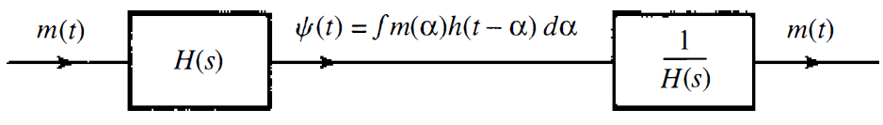
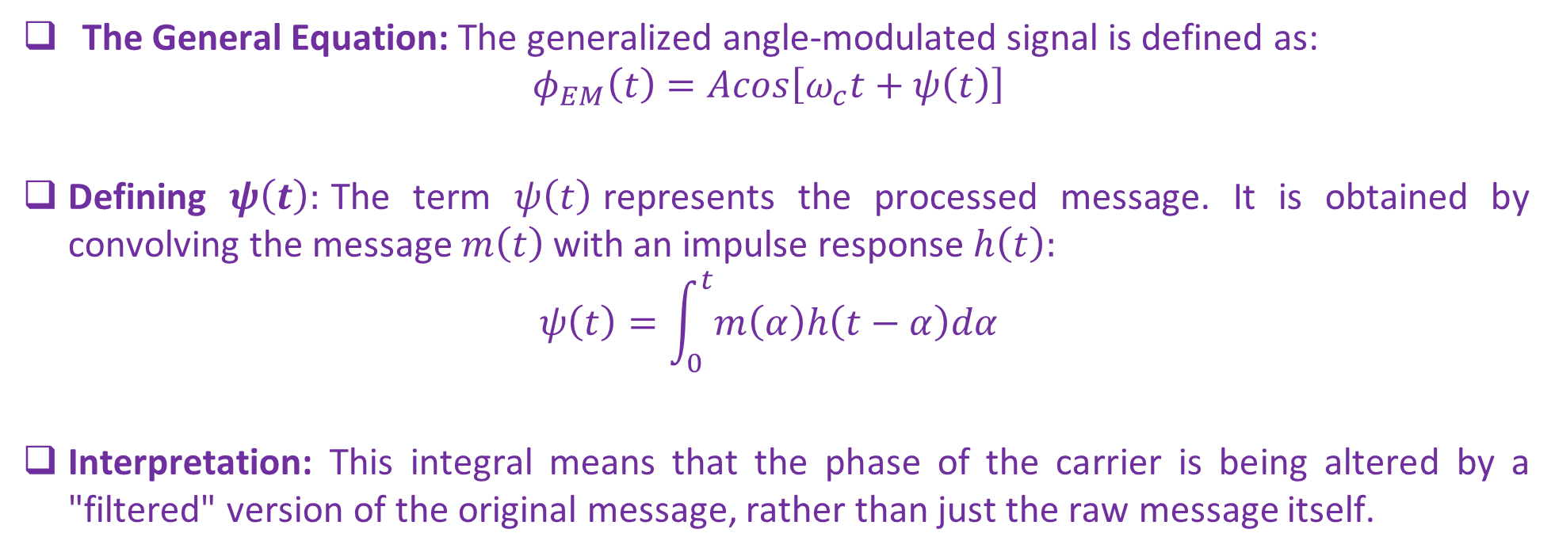
Generalized Angle Modulation: Concept
The General Equation: The generalized angle-modulated signal is defined as:
$$φ_{EM}\left(t\right)=Acos\left[ω_{c}t+ψ\left(t\right)\right]$$
Defining $ψ\left(t\right):$The term $ψ\left(t\right)$represents the processed message. It is obtained by convolving the message $m\left(t\right)$with an impulse response $h\left(t\right):$
$$ψ\left(t\right)=\int_{0}^{t}{m\left(α\right)h\left(t−α\right)dα}$$
Interpretation: This integral means that the phase of the carrier is being altered by a "filtered" version of the original message, rather than just the raw message itself.
Invertible
LTI System

Slide 35
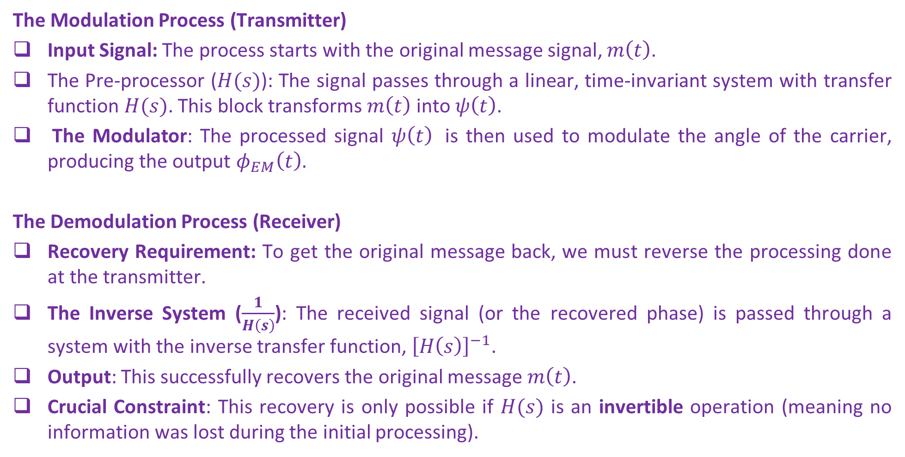
Generalized Angle Modulation: System Architecture
The Modulation Process (Transmitter)
Input Signal: The process starts with the original message signal, $m\left(t\right)$.
The Pre-processor ($H(s)$): The signal passes through a linear, time-invariant system with transfer function $H(s)$. This block transforms $m\left(t\right)$ into $ψ\left(t\right)$.
The Modulator: The processed signal $ψ\left(t\right)$ is then used to modulate the angle of the carrier, producing the output $φ_{EM}\left(t\right)$.
The Demodulation Process (Receiver)
Recovery Requirement: To get the original message back, we must reverse the processing done at the transmitter.
The Inverse System ($\frac{1}{H\left(s\right)}$): The received signal (or the recovered phase) is passed through a system with the inverse transfer function, ${\left[H\left(s\right)\right]}^{−1}$.
Output: This successfully recovers the original message $m\left(t\right)$.
Crucial Constraint: This recovery is only possible if $H(s)$ is an invertible operation (meaning no information was lost during the initial processing).

Slide 36
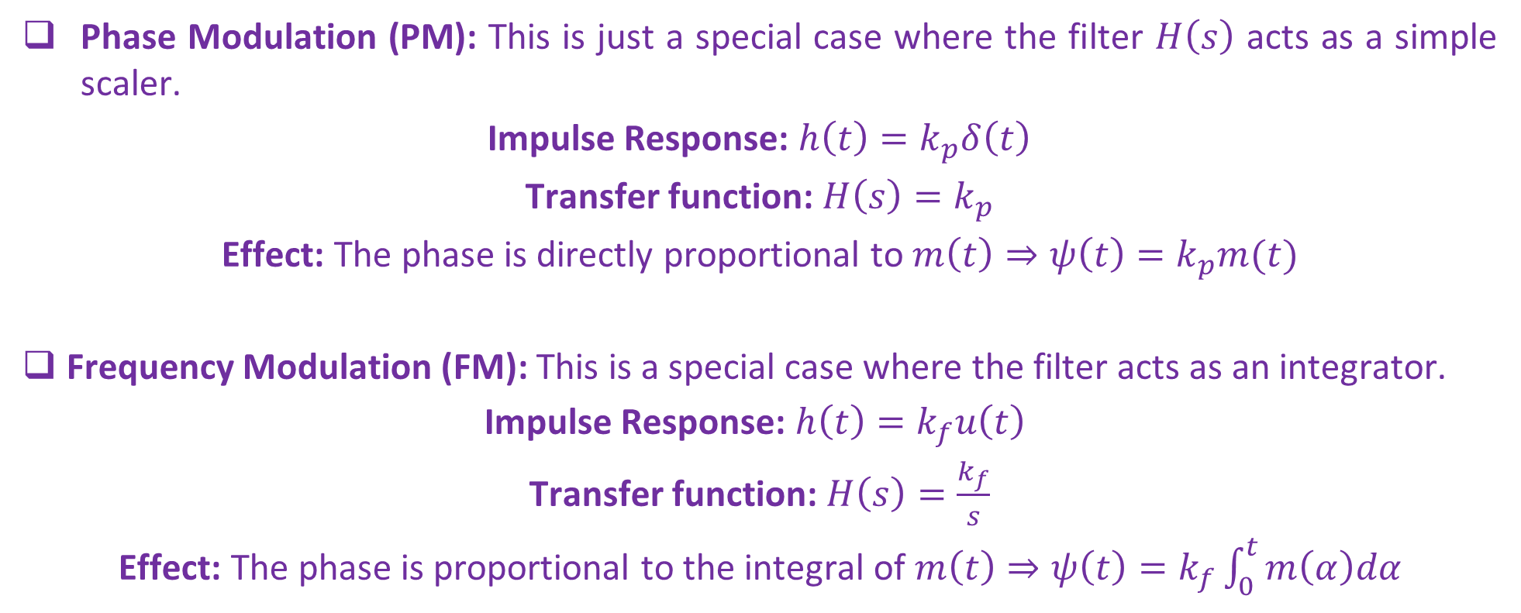
Generalized Angle Modulation: FM and PM as Special Cases
Invertible
LTI System
Phase Modulation (PM): This is just a special case where the filter $H\left(s\right)$ acts as a simple scaler.
Impulse Response: $h\left(t\right)=k_{p}δ\left(t\right)$
Transfer function: $H\left(s\right)=k_{p}$
Effect: The phase is directly proportional to $m\left(t\right)⇒ψ\left(t\right)=k_{p}m(t)$
Frequency Modulation (FM): This is a special case where the filter acts as an integrator.
Impulse Response: $h\left(t\right)=k_{f}u\left(t\right)$
Transfer function: $H\left(s\right)=\frac{k_{f}}{s}$
Effect: The phase is proportional to the integral of $m\left(t\right)⇒ψ\left(t\right)=k_{f}\int_{0}^{t}{m\left(α\right)dα}$

Slide 37
Why PM is Practically Superior?
No DC Drift: FM's integration can cause carrier frequency drift
Better Phase Stability: PM maintains better phase relationships
Easier Synchronization: PM systems often have cleaner phase references
Spectrum Efficiency: PM can have more compact spectrum in some cases

